Slide 1
Event Management
18BCE135, 18BCE192

Slide 2
Mapping Cardinality
Entity 1 | Relation | Entity 2 | Cardinality
Customer | Has | Order | 1:N
Customer | Gives | Review | 1:1
Order | Has | Invoice | 1:1
Professional | Is | Unavailable | 1:1

Slide 3
Keys
Table | Primary Key | Foreign Key
User | UID
Customer | UID | UID
Professional | UID | UID
Hall | UID | UID
Caterer | UID | UID
Photographer | UID | UID
Order | OrID | CID,PID
Invoice | IID | PID,CID,OrID
Review | OrID,PID,CID
Unavailable | UID

Slide 4
Composite Attribute
Name
( First name , Middle name, Last name )
Name
Fname
Mname
Lname
Address
( Line 1 , Line 2, Pincode )
Address
AddressLine1
AddressLine2
Pincode

Slide 5
Multivalued Attribute
User can have multiple phone numbers.
So we made new table to store Phone Number to avoid redundancy in User table.
UID | PhoneNumber
User1 | Ph1
User1 | Ph2
User2 | Ph1

Slide 6
Derived Attributes
We used Derived Attributes that are listed below
Rating – derives from reviews
Category – derives from price
Total – derives from package

Slide 7
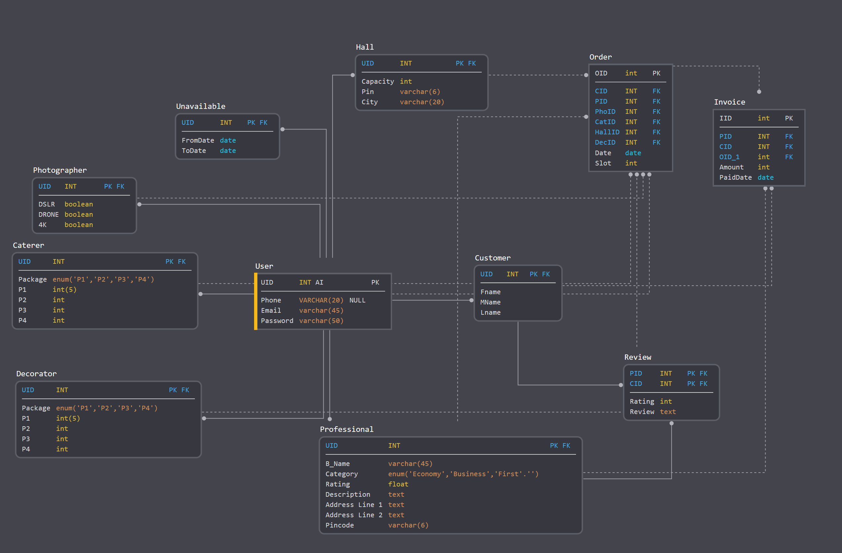
Relational Model

